Slide 1

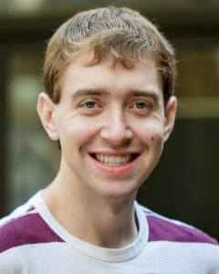
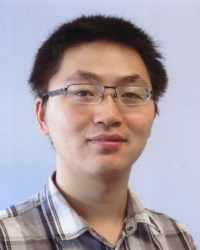
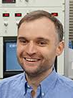
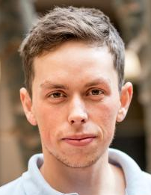
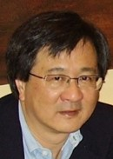
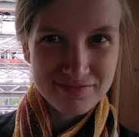
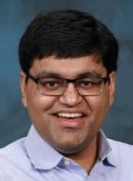
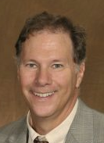
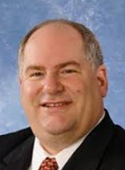
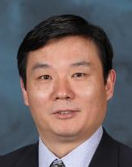



Princeton, July 12, 2023
Intro to the Thermal transport
in the Kitaev magnet α-RuCl₃
P. Lampen-Kelley
S. Nagler
JQ Yan
Peter Czajka
Max
Hirschberger
(RIKEN, Tokyo)
Nick Quirk
NPO
A. Banerjee
(Purdue U.)
D. Mandrus
Tong Gao
Princeton Univ.
Univ. of Tennessee
Oak Ridge National Lab
The planar thermal Hall conductivity K_{xy.} Czajka et al., Nat Mater. 2022
Berry curvature or Majoranas?
Chiral edge modes occupied by bosons
Chern number
2. Oscillations in thermal conductivity K_{xx} in QSL state
Czajka et al., Nat. Phys. 2021
Supported by GB Moore Foundation, DOE, NSF

Slide 2
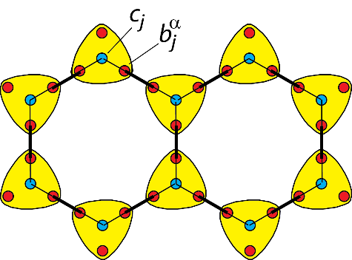
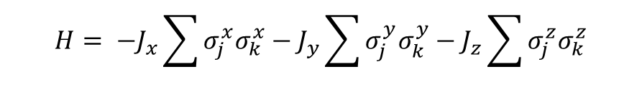

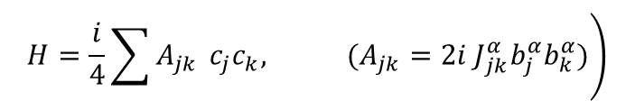
The Kitaev honeycomb model
Exchange frustration
$$H= −J_{x}\sum{σ_{j}^{x}σ_{k}^{x}}−J_{y}\sum{σ_{j}^{y}σ_{k}^{y}}−J_{z}\sum{σ_{j}^{z}σ_{k}^{z}}$$
(Kitaev, Annals Phys., 2006)
Replace each spin $σ_{j}^{x}$ by 1 b_{j} and 3 c_{j} Majoranas
$$\left.H=\frac{i}{4}\sum{A_{jk}} c_{j}c_{k}, (A_{jk}=2i J_{jk}^{α}b_{j}^{α}b_{k}^{α})\right)$$
Using Majorana representation, Kitaev obtained the exact ground-state (B=0).
Its excitations are Majoranas and vortices (“visons”)
Jackeli and Khaliullin (PRL, 2009) realized Kitaev’s Hamiltonian in
transition metal oxides with edge shared tetrahedra.
Community identified α-RuCl₃ as best proximate.

Slide 3

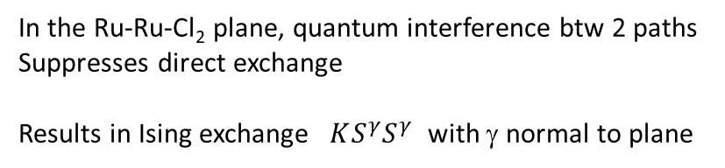
Jackeli-Khaliullin realization of the Kitaev model in Ir and Ru chalcogenides
Jackeli, Khaliullin, PRL 2009
$$S^{γ}$$
spin orbit coup.
Ru-Ru-Cl₂ plane
Edge-sharing octahedra
Takagi et al., Nat. Rev. Phys. 2019
Strong spin orbit coupling → lone hole occupies J_{eff} = ½ doublet
In the Ru-Ru-Cl₂ plane, quantum interference btw 2 paths
Suppresses direct exchange
Results in Ising exchange $KS^{γ}S^{γ}$ with γ normal to plane

Slide 4
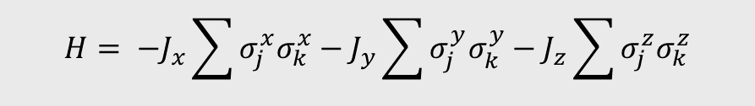
Lattice structure and Kitaev spin axes in α-RuCl₃
$$H= −J_{x}\sum{σ_{j}^{x}σ_{k}^{x}}−J_{y}\sum{σ_{j}^{y}σ_{k}^{y}}−J_{z}\sum{σ_{j}^{z}σ_{k}^{z}}$$
(Kitaev, Annals Phys., 2006)
S_{z}
S_{y}
S_{x}
Kim and Kee, PRB (2016)
Crystals are highly susceptible to stacking fault formation.

Slide 5
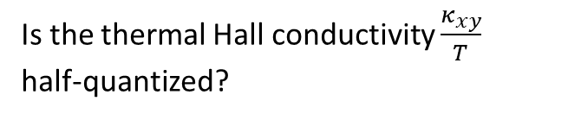
Phase diagram of α-RuCl₃ (with B || a)
α-RuCl₃ is closest proximate to Kitaev QSL
(Plumb, Sears, Banerjee, Lampen-Kelley,
Leahy, Hentrich, Kasahara, …)
terms lead to AF zigzag state
below 7 K with B=0.
In plane H of 7.3 T suppresses zigzag order
QSL state stable in interval (7.3, 11.6 T).
Is the thermal Hall conductivity $\frac{κ_{xy}}{T}$ half-quantized?
Kasahara et al. Nature (2018)
Yokoi et al. Science (2021)

Slide 6
Nature 2018
Measurements from 3.7 to 4.9 K. What happens below 3.7 K?

Slide 7
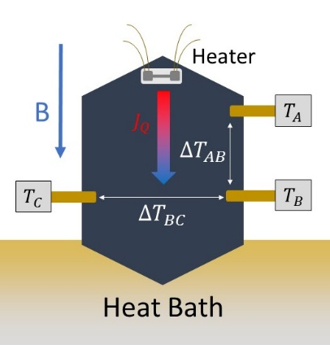





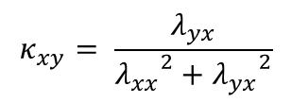

Measurements of thermal conductivity tensor K_{ij}
5-mil Au wire
heater
armchair
zigzag
Thermal current density J_{Q}
$$J_{Q}= \tilde{κ} (−∇T)$$
Delrin post
With $J_{Q}$ $∥a$ $∥x$ , we measure
Sample 1
Sample 2
$$δ_{x}T = λ_{xx}(−J_{Q})$$
$$δ_{y}T = λ_{yx}(−J_{Q})$$
$$\tilde{κ}={\tilde{λ}}^{−1}$$
We measure the thermal resistivity matrix $λ_{ij}$.
$$κ_{xy}= \frac{λ_{yx}}{{λ_{xx}}^{2}+{λ_{yx}}^{2}}$$
Infer
Then invert $λ_{ij}$to get thermal conductivity matrix $κ_{ij}$.

Slide 8
Major challenge in Kxy expt. -- I) Magnetocaloric Effect
Effects of magneto-calorific effect and eddy-current heating

Slide 9
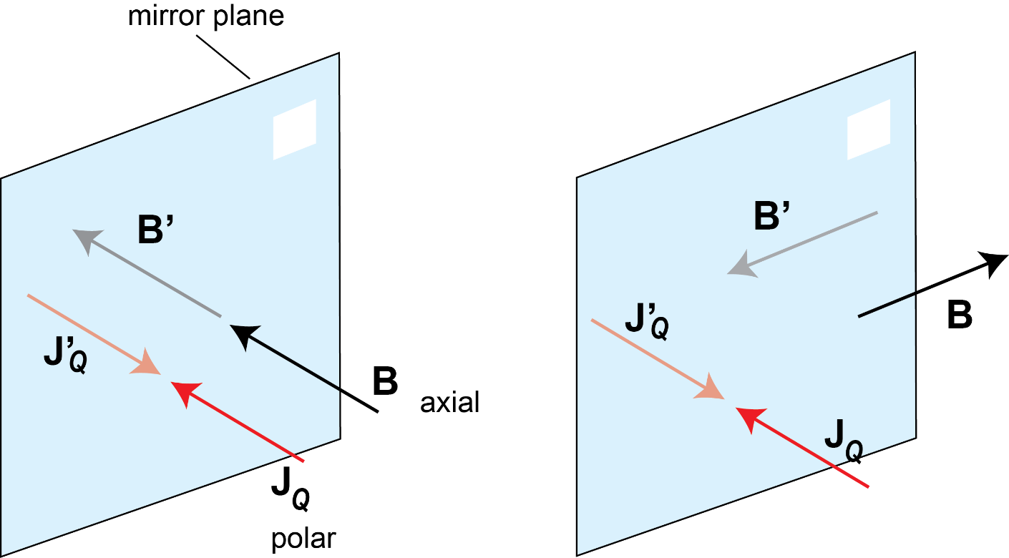
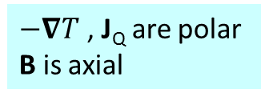
Mirror symmetry, handedness, and Thermal Hall Effect
$−∇T$ , J_{Q} are polar
B is axial
$$−∇T$$
$$−∇T$$
B aligned normal to mirror.
Preserves mirror symmetry.
Thermal Hall current J_{Q} (or K_{xy}) must vanish!
B aligned parallel to mirror plane.
Breaks mirror symmetry.
Allows finite J_{Q} (K_{xy}) to exist.

Slide 10
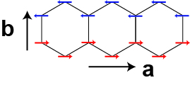


No thermal Hall signal from 0.29 to 5 K for $H∥b$
Resolution to 50 µK, uncertainty of $±150 μK$
H
300 µK
B||b
B||a
With H||a, thermal Hall signal emerges above 3 K.
First reported by Kyoto group (Yokoi et al.)
Peter Czajka

Slide 11



Curves of $λ_{yx}$ vs. B at fixed T
Inferred curves of $κ_{xy}$ vs. B
For B>10 T and T<4 K, $κ_{xy}≈λ_{yx}κ_{xx}^{2}$ has huge uncertainties (product of 0 and ${10}^{3})$
$κ_{xy}$ is strongly T dependent at all B measured.
Non-intersecting curves of $κ_{xy}$ suggests taking fixed-T cuts.

Slide 12
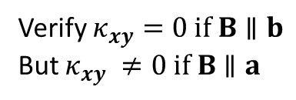


Planar thermal Hall effect for B || a
B $∥$a
~50 curves
T = 7 K
Thermal Hall signal antisymm. in B
Color map of $λ_{yx}$ in B-T plane
Small negative region
Verify $κ_{xy}=0 if B∥b$
But $κ_{xy} ≠0 if B∥a$
Confirms findings of Yokoi et al. (Science 2021)

Slide 13
Berry Curvature and chiral edge modes

Slide 14





Neutral excitations can exhibit a thermal Hall effect (Hirschbeger et al., Science 2015)
cool
Luttinger anomalous velocity
$$Ω$$
$${ℏv}_{A}=−∇U×Ω(k)$$
$$−∇T$$
x
Berry curvature $Ω;$Wall potential U
warm
y
Leads to a chiral edge thermal current.
In a thermal gradient $−∇T$, a finite K_{xy} emerges.
See Nagaosa et al., Rev. Mod. Phys. 2010

Slide 15
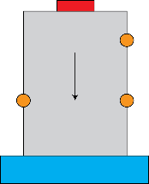
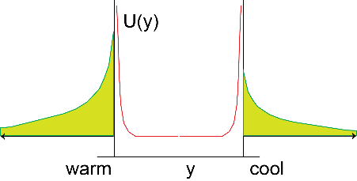

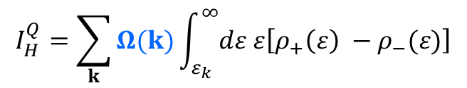




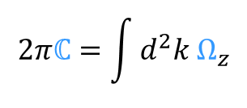



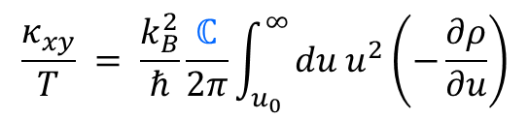

Thermal Hall conductivity K_{xy} (semiclassical)
Kane, Fisher (1996)
Cooper, Halperin (1997)
Matsumoto, Murakami (2011)
Niu (2011)
bath
wall potl
$$E →$$
U(x)
Ω
T
T
A
B
J
Q
Bose distrib ρ₋
T
C
x
Edge current
$$ε_{k}$$
$$ρ$$
heater
x
y
Bose-Einstein distrib. $ρ(u)$.
Luttinger velocity v_{A}
$${ℏv}_{A}=−∇U×Ω(k)$$
$$ρ\left(u\right)={(e^{u}−1)}^{−1}$$
$$I_{H}^{Q}=\sum_{k}{Ω(k)}\int_{ε_{k}}^{∞}{dε ε\left[ρ_{+}\left(ε\right) −ρ_{−}(ε)\right]}$$
Berry curvature $Ω(k)$
$$\frac{κ_{xy}}{T} = \frac{k_{B}^{2}}{ℏ}\frac{ℂ}{2π}\int_{u_{0}}^{∞}{du u^{2}\left(−\frac{∂ρ}{∂u}\right)}$$
$$(u_{0}= βε_{k})$$
Chern number $ℂ$
$$2πℂ=\int{d^{2}k Ω_{z}}$$

Slide 16

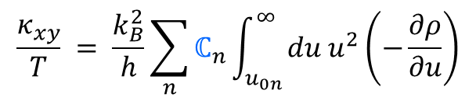

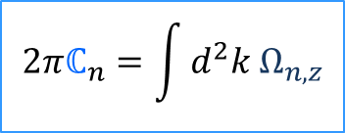








Microscopic theory of $κ_{xy}$
Matsumoto and Murakami
(2011, 2014)
$$F_{ext}$$
Semiclassical derivation
Luttinger velocity v_{A}
$${ℏv}_{A}=−∇U×Ω(k)$$
$$I_{H}^{Q}=\sum_{k,n}{Ω_{n}(k)}\int_{ε_{k}}^{∞}{dε ε\left[ρ_{+}\left(ε\right) −ρ_{−}(ε)\right]}$$
Berry curvature $Ω(k)$
Bose-Einstein distrib. $ρ(u)$.
Chern number $ℂ$
$$\frac{κ_{xy}}{T} = \frac{k_{B}^{2}}{h}\sum_{n}{ℂ_{n}\int_{u_{0n}}^{∞}{du u^{2}\left(−\frac{∂ρ}{∂u}\right)}}$$
$$ρ\left(u\right)={(e^{u}−1)}^{−1}$$
cool
$$(u_{0n}= βω_{nk})$$
$$Ω$$
$$2πℂ_{n}=\int{d^{2}k Ω_{n,z}}$$
Winding number
$$−∇T$$
x
warm
y

Slide 17

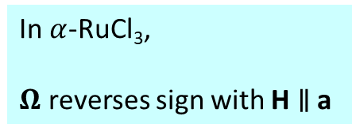
Finite Berry curvature $Ω$ in spin excitation bands of Kitaev magnet
H comprised of J, K and $Γ$ terms
McClarty, et al., PRB (2018)
Joshi, PRB (2018)
Chern, Zhang, Kim, PRL (2021)
Chern, Zhang, Kim, PRL 2021
In $α$-RuCl₃,
$Ω$ reverses sign with H $∥$ a
Planar Hall geometry
H

Slide 18



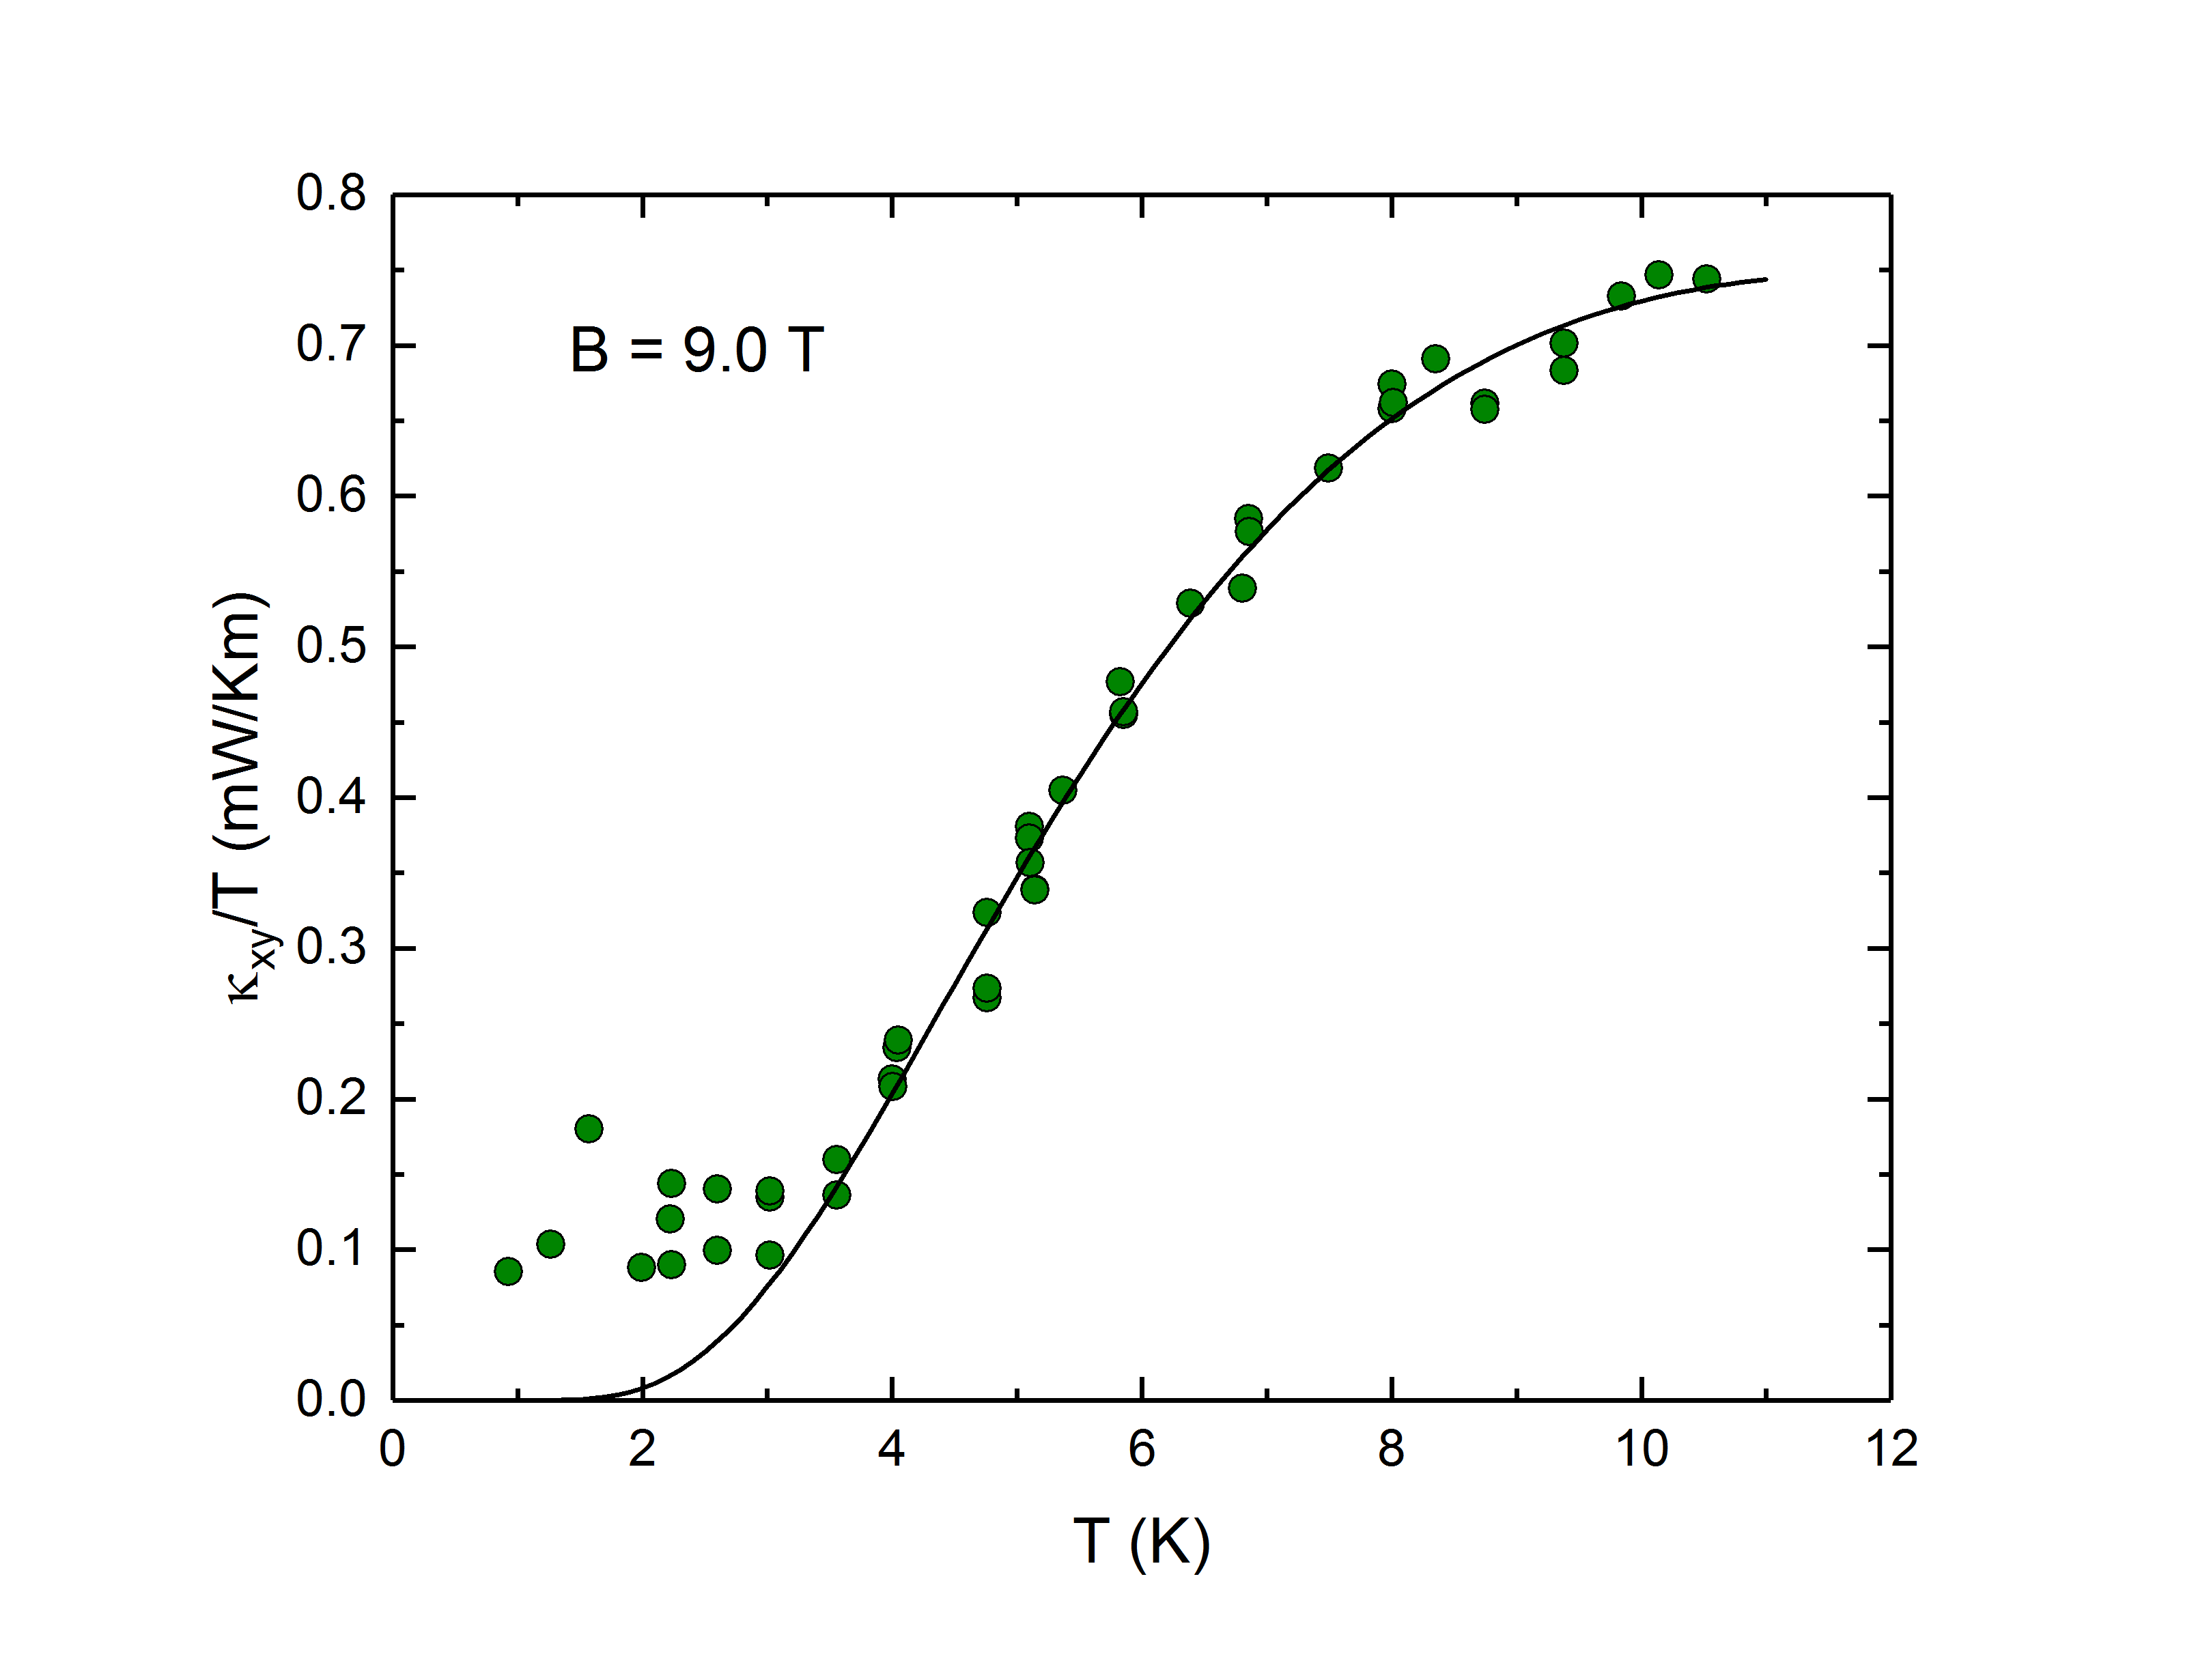
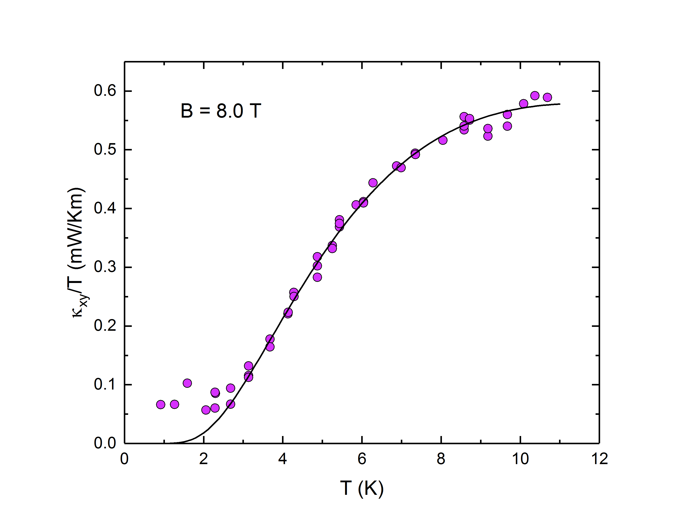

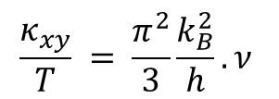
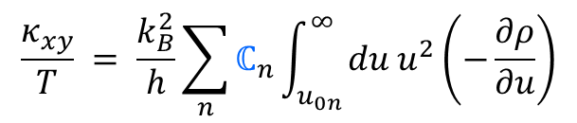



Fermions or Bosons in edge mode?
$$\frac{κ_{xy}}{T} = \frac{k_{B}^{2}}{h}\sum_{n}{ℂ_{n}\int_{u_{0n}}^{∞}{du u^{2}\left(−\frac{∂ρ}{∂u}\right)}}$$
$$(u_{0n}= βω_{n})$$
Czajka, Gao, Hirschberger
Two band fit
$$c_{2}(ω_{n},T)$$
Fermion (arb. units)
Fermion (arb. units)
2
2
boson
boson
For fermions, $\frac{κ_{xy}}{T}$ is T independent.
$$\frac{κ_{xy}}{T} = \frac{π^{2}}{3}\frac{k_{B}^{2}}{h}.ν$$
$$ν∈ℤ$$
Kane Fisher (1996)
Data verify bosons

Slide 19
Grey data represent important deviations from Murakami’s expression.

Slide 20
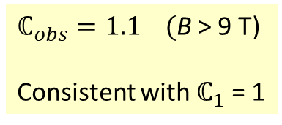



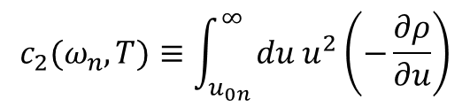
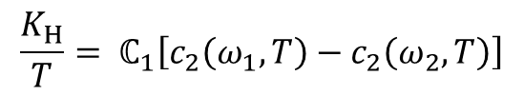
Chern-number check:
Overall scale of $κ_{xy}/T$ is fixed by $ℂ$ = 1
$$\frac{κ_{xy}}{T} = \frac{k_{B}^{2}}{h}\sum_{n}{ℂ_{n}\int_{u_{0n}}^{∞}{du u^{2}\left(−\frac{∂ρ}{∂u}\right)}}$$
In universal units $k_{B}^{2}/h$
$$\frac{K_{H}}{T}= ℂ_{1}\left[c_{2}\left(ω_{1},T\right)−c_{2}\left(ω_{2},T\right)\right]$$
$$c_{2}(ω_{n},T)≡\int_{u_{0n}}^{∞}{du u^{2}\left(−\frac{∂ρ}{∂u}\right)}$$
$ℂ_{obs}=1.1 ($B > 9 T)
Consistent with $ℂ_{1}$ = 1

Slide 21


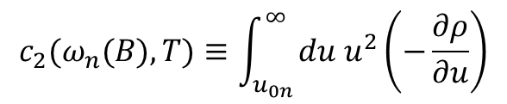
Check for energy of lowest band $ω_{1}$
$$c_{2}(ω_{n}(B),T)≡\int_{u_{0n}}^{∞}{du u^{2}\left(−\frac{∂ρ}{∂u}\right)}$$
At 7 T, energy $ω_{1}$= 1 meV
In close agreement with dominant
sharp mode seen in
ESR
THz microwave absorption
Neutron scattering

Slide 22
Evidence against a phonon planar Hall effect in $α$-RuCl₃
Profiles of Kxx vs T qualitatively different from Kxy vs. T

Slide 23
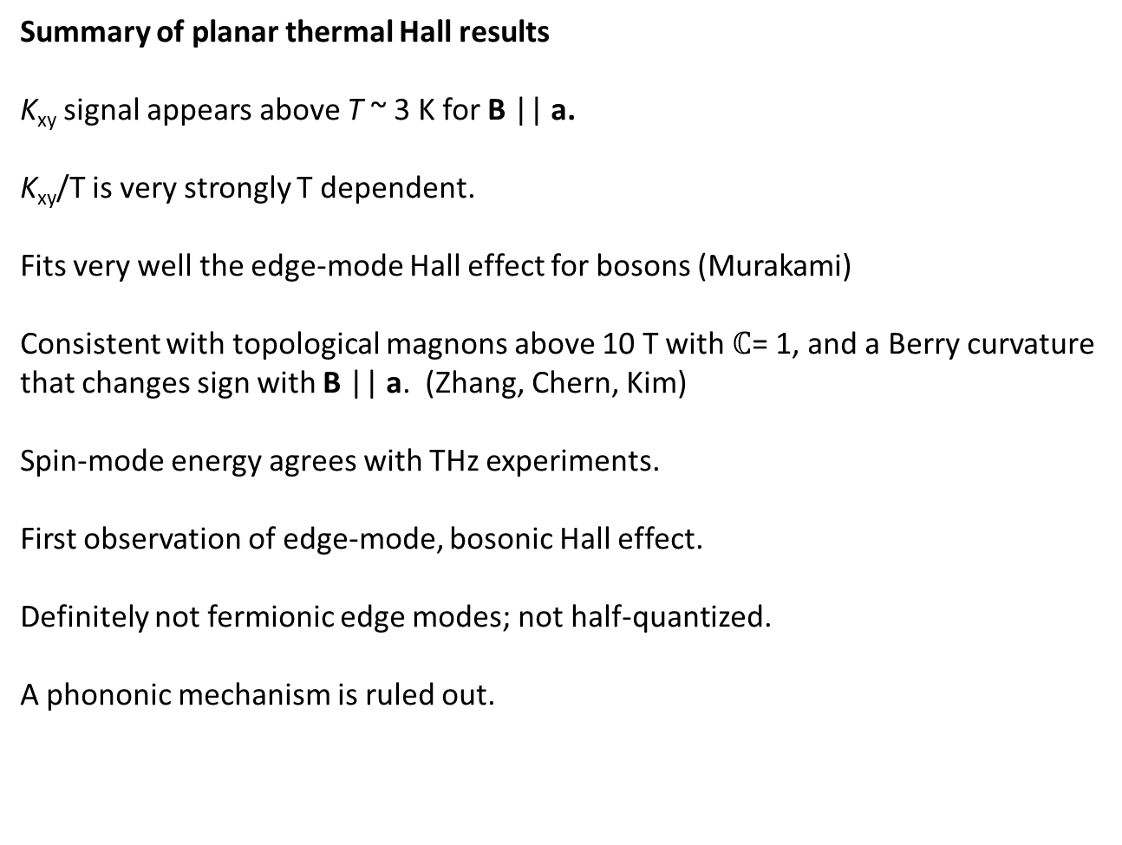
Summary of planar thermal Hall results
K_{xy} signal appears above T ~ 3 K for B || a.
K_{xy}/T is very strongly T dependent.
Fits very well the edge-mode Hall effect for bosons (Murakami)
Consistent with topological magnons above 10 T with $ℂ$= 1, and a Berry curvature
that changes sign with B || a. (Zhang, Chern, Kim)
Spin-mode energy agrees with THz experiments.
First observation of edge-mode, bosonic Hall effect.
Definitely not fermionic edge modes; not half-quantized.
A phononic mechanism is ruled out.

Slide 24
Oscillations in Kxx

Slide 25
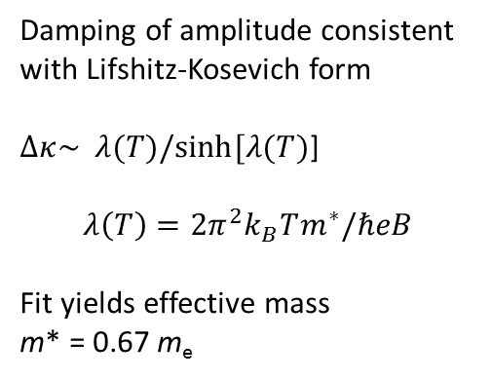
Oscillation amplitude decreases as T rises, but planar Kxy increases
Czajka et al., Nat. Phys. 2021
Osc. ampl.
Damping of amplitude consistent with Lifshitz-Kosevich form
$Δκ\sim λ(T)/sinh⁡[λ(T)$]
$$λ\left(T\right)=2π^{2}k_{B}Tm^{∗}/ℏeB$$
Fit yields effective mass
m* = 0.67 m_{e}
Kxy
Oscillations (bulk, fermionic?) and planar Kxy (edge, bosonic) seem to involve different populations of spin excitations

Slide 26
Oscillations in K_{xx} emerge below 4 K with $B∥a$
Czajka et al., Nat. Phys. (2021).
Czajka, Gao, Hirschberger
H || a
H || a
Amplitude largest in interval 7 – 11.5 T (QSL state)
Above 11.5 T, K_{xx} steps up to an H-independent value
Below 7 T, weak oscillations resolved in zig-zag phase

Slide 27
Amplitude function $Δκ_{amp}(H)$ is large in QSL state
Amplitude is large in QSL (7.3 < B < 11.5 T).
Abruptly vanishes above 11.5 T. Extends as a weak tail to 4 T in zigzag phase (mixed phase?).

Slide 28
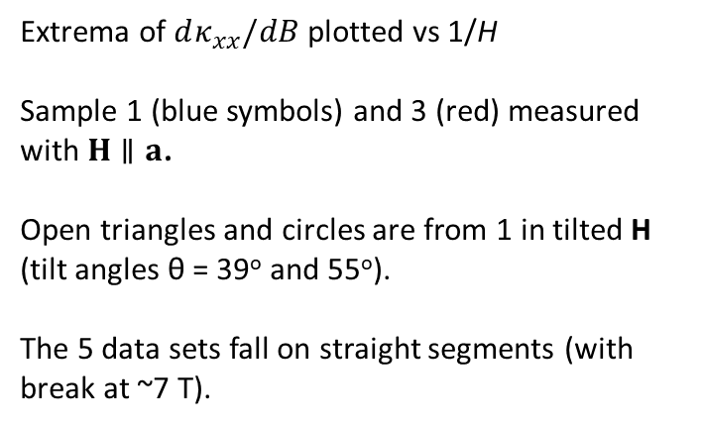
“Index plot” of integer increment Δn vs 1/H
c
H
θ
a
Extrema of $dκ_{xx}/dB$ plotted vs 1/H
Sample 1 (blue symbols) and 3 (red) measured with $H∥a$.
Open triangles and circles are from 1 in tilted H (tilt angles θ = 39º and 55º).
The 5 data sets fall on straight segments (with break at ~7 T).
Oscillations mimic Landau-level oscillations, but there are no free electrons!
Gap is 2 eV (from ARPES). At 1 K, free electrons are exponent^{y} suppressed.
Effective “Fermi surface” area = 30 T (below 7 T) and 41 T or 64 T (above 7 T).

Slide 29
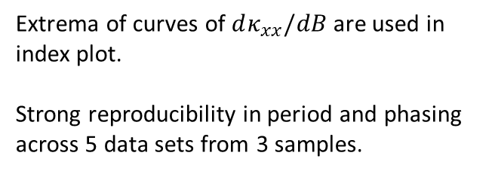
Reproducibility of oscillation period and phasing
Extrema of curves of $dκ_{xx}/dB$ are used in index plot.
Strong reproducibility in period and phasing across 5 data sets from 3 samples.
Plot vs. H shows that sequence is not periodic in H.

Slide 30
PRB 2015
Crystal with multiple stacking faults
Crystal without stacking faults
Multiple
Transit^{n} model
(withdrawn)

Slide 31
ORNL recent results Zhang, Yan et al. Arxiv 2303…
Czajka et al. Nat Phys
T_{N} = 6.5 K
T_{N} = 7.6 K

Slide 32
P. Lampen-Kelley
S. Nagler
JQ Yan
A. Banerjee
(Purdue)
D. Mandrus
Peter Czajka
Tong Gao
Max
Hirschberger
(RIKEN, Tokyo)
NPO
Thank you

