Slide 1




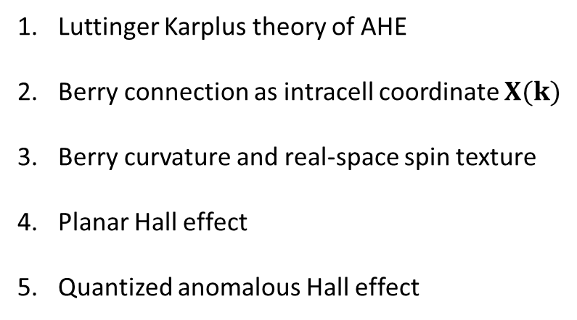
Introduction to Berry Curvature effects in transport
experiments in topological matter
N. P. Ong, Princeton Univ.
Luttinger Karplus theory of AHE
Berry connection as intracell coordinate $X(k)$
Berry curvature and real-space spin texture
Planar Hall effect
Quantized anomalous Hall effect
Supported by GB Moore Foundation, DOE, NSF

Slide 2
Karplus-Luttinger theory of the anomalous Hall effect (1955)

Slide 3
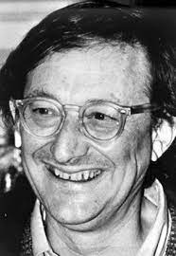






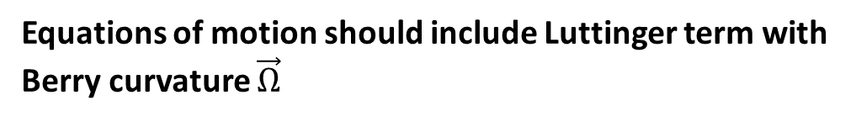
Equations of motion should include Luttinger term with Berry curvature $\vec{Ω}$
$ℏ\dot{k} =eE+ev×B$
All textbooks
Quinn Luttinger
$$ℏv=∇_{k}ε$$
Karplus, Luttinger (‘54)
$ℏ\dot{k} =eE+ev×B$
Adams, Blount (‘59)
Luttinger (‘54, ‘64)
$$ℏv=∇_{k}ε+Ω(k)×F_{ext}$$
$$𝓘=i\left\langle nk | ∇ |nk\right\rangle$$
$$Ω= ∇×𝓘$$
Anomalous velocity
$$ℏv_{A}=Ω(k)×F_{ext}$$
Implication for Hall current -- existence of a transverse current
that is field antisymmetric and dissipationless.
In most crystals, $Ω$ vanishes by TR invariance and inversion symmetry

Slide 4
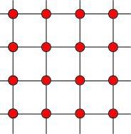


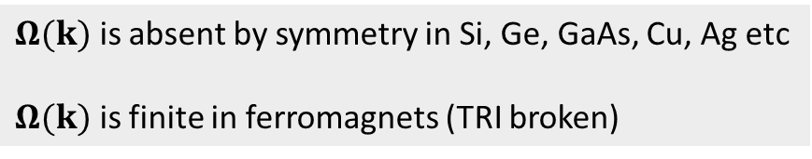






Intracell coordinate in wave packet motion
Luttinger, Kohn, Roth, Blount, … Berry, Niu, …
Wannier coord. R
$$x=R+X(k)$$
with $X(k)$the intracell coordinate
$$X(k)$$
$$H= ε\left(k \right)+V(R+X(k))$$
$$R$$
The Berry curvature $Ω(k)$ “lives in” k-space.
$$x$$
$$Ω(k)=∇×X(k)$$
Present in all crystals, but vanishes by symmetry if time-reversal and inversion symmetry are both present.
$Ω(k)$ is absent by symmetry in Si, Ge, GaAs, Cu, Ag etc
$Ω(k)$ is finite in ferromagnets (TRI broken)

Slide 5
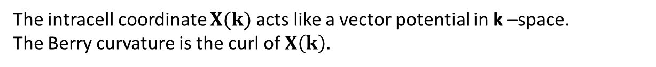




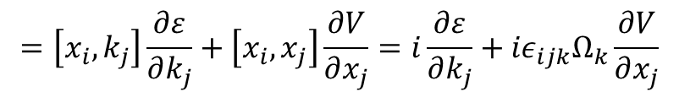




Adams-Blount derivation of Luttinger eqn
$$H= ε\left(k \right)+V(R+X(k))$$
$$x=R+X$$
Adams, Blount ‘59
The intracell coordinate $X(k)$ acts like a vector potential in k –space.
The Berry curvature is the curl of $X\left(k\right).$
$Ω= ∇×X$, or $\left(\frac{∂X_{j}}{∂k_{i}}−\frac{∂X_{i}}{∂k_{j}}\right)=ε_{ijk}Ω_{k}.$
$x$ fails to commute with itself.
$$\left[x_{i},x_{j}\right]=\left[R_{i}+X_{i},{ R}_{j}+ X_{j} \right]$$
$=\left[R_{i},k_{k}\right]\frac{∂X_{j}}{∂k_{k}}+\left[k_{k},R_{j}\right]\frac{∂X_{i}}{∂k_{k}}=i\left(\frac{∂X_{j}}{∂k_{i}}−\frac{∂X_{i}}{∂k_{j}}\right)={iε}_{ijk}Ω_{k}$
Extra term in the velocity ${\dot{x}}_{i}$
$$=\left[x_{i},k_{j}\right]\frac{∂ε}{∂k_{j}}+\left[x_{i},x_{j}\right]\frac{∂V}{∂x_{j}}=i\frac{∂ε}{∂k_{j}}+{iε}_{ijk}Ω_{k}\frac{∂V}{∂x_{j}}$$
$$i{\dot{x}}_{i}=\left[x_{i}, H\right]$$
$$ℏv=∇_{k}ε+ Ω×F_{ext}$$

Slide 6
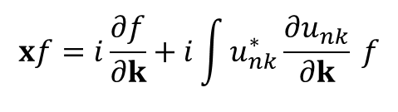





Buried implications of Luttinger’s theory
1. The intracell coordinate cannot be ignored.
Identify “connection”
$$x=R+X(k)$$
$$xf=i\frac{∂f}{∂k}+i\int{u_{nk}^{∗}}\frac{∂u_{nk}}{∂k} f$$
$$X\left(k\right)=i\left\langle nk | ∇|nk\right\rangle$$
Hereafter, relabel $X\left(k\right)$ as $A\left(k\right)$
2. Existence of Berry curvature $Ω$and anomalous velocity in all crystals
$$Ω= ∇×A$$
$$ℏv=∇_{k}ε+ Ω×F_{ext}$$
3. The anomalous Hall effect in ferromagnets is a direct manifestation of $Ω$

Slide 7
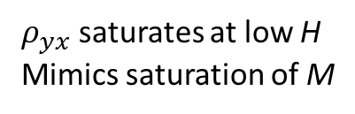





Intrinsic vs extrinsic (skew scattering) mechanism for anomalous Hall effect (AHE)
Karplus Luttinger theory (intrinsic)
The anomalous Hall effect
$σ_{xy}$
is independent of lifetime $τ$
$$ρ_{yx}=σ_{xy}ρ^{2} \sim ρ^{2}$$
Skew-scattering theory (extrinsic)
$σ_{xy} \sim τ$
$ρ_{yx}=σ_{xy}ρ^{2} \sim ρ$
$ρ_{yx}$ saturates at low H
Mimics saturation of M
Experimental results supported both predictions
But from measurements vs. T in one sample

Slide 8
Science 2004
In spinel CuCr₂Se₄, magnetization M
arises from direct exchange between S
(local moments) in Cr.
Itinerant carriers play no role in exchange.
Increasing dopant Br depletes carriers.
Allows ideal platform to investigate
how AHE is affected by altering carrier density
with M unchanged.

Slide 9
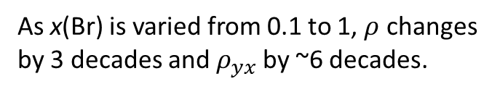

As x(Br) is varied from 0.1 to 1, $ρ$ changes
by 3 decades and$ρ_{yx}$ by ~6 decades.
Strong evidence supporting
$$ρ_{yx} \sim ρ^{2}$$
and a dissipationless Hall current.
AHE is intrinsic in CuCr₂Se₄ spinel

Slide 10
Berry phase and Berry Curvature

Slide 11
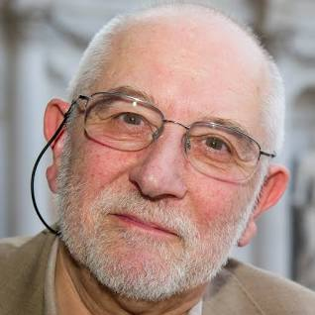

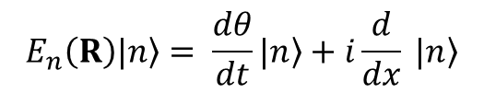
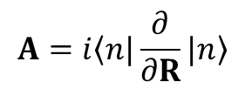

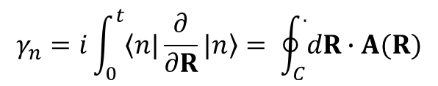

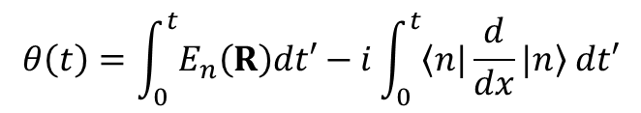

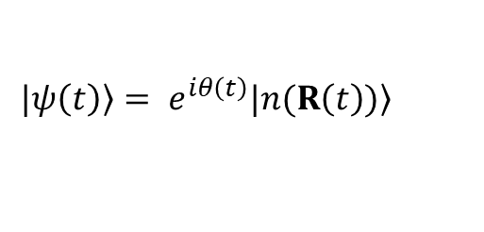

The Berry phase of an electron in a tilted field
Spin ½ in precessing magnetic field (written as R(t))
Michael Berry
R(t)
$$H=−μσ∙R(t)$$
$$|\left.ψ\left(t\right)\right\rangle = e^{iθ\left(t\right)}|\left.n(R\left(t\right))\right\rangle$$
$$θ$$
$$E_{n}\left(R\right)\left.|n\right\rangle = \frac{dθ}{dt}|\left.n\right\rangle +i\frac{d}{dx} \left.|n\right\rangle$$
$$σ$$
$$θ\left(t\right)=\int_{0}^{t}{E_{n}\left(R\right)dt′}−i\int_{0}^{t}{\left\langle n|\right.\frac{d}{dx}\left.|n\right\rangle dt′}$$
$$φ$$
usual dynamic phase
geometric (Berry) phase $γ_{n}$
$$γ_{n}=i\int_{0}^{t}{\left\langle n|\right.\frac{∂}{∂R}\left.|n\right\rangle }= \oint_{C}^{.}{dR∙A(R)}$$
Closed loop C
Berry vector potential
(connection)
$$A=i\left\langle n|\right.\frac{∂}{∂R}\left.|n\right\rangle$$

Slide 12


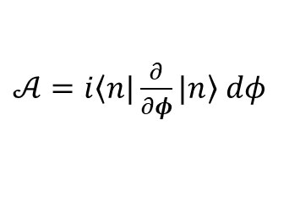





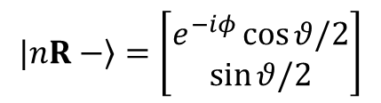

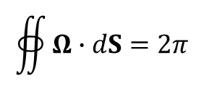
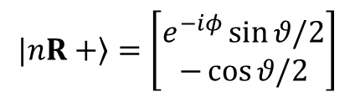
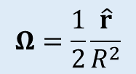

$$H=−μσ∙R(t)$$
1-form vs vector rep.
$$df= \frac{∂f}{∂φ}dφ+⋯={\hat{e}}_{φ}∙∇f$$
Eigenstates
$$|\left.nR+\right\rangle =\left[\begin{matrix}e^{−iφ}\sin{θ/2} \\ −\cos{θ/2}\end{matrix}\right]$$
$$|\left.nR−\right\rangle =\left[\begin{matrix}e^{−iφ}\cos{θ/2} \\ \sin{θ/2}\end{matrix}\right]$$
$A_{+}= \frac{\frac{1}{2}(1−\cos{θ) }}{rsin θ}$ ${\hat{e}}_{φ}$
Berry potential 1-form
$𝒜=i\left\langle n|\right.\frac{∂}{∂φ}\left.|n\right\rangle dφ$
Nakahara
$$𝒜_{+}=\frac{1}{2}(1−\cos{θ) dφ}$$
$$𝒜_{−}=\frac{1}{2}(1+\cos{θ) dφ}$$
Berry curvature 2-form
$Ω_{θφ}^{+}=\frac{1}{2}\sin{θ}$ $dθ⋀dφ$
$$Ω_{θφ}=d𝒜$$
Berry curvature vector
is tedious to calc. but
surprisingly simple!
$Ω^{+}=∇×\frac{\frac{1}{2}(1−\cos{θ) }}{rsin θ}$ ${\hat{e}}_{φ}$
$$∇= {\hat{e}}_{r}\frac{∂}{∂r}+{\hat{e}}_{θ}\frac{1}{r}\frac{∂}{∂θ}+{\hat{e}}_{φ}\frac{1}{rsinθ}\frac{∂}{∂φ}$$
Has form of monopole field
(strength ½)
$$Ω=\frac{1}{2}\frac{\hat{r}}{R^{2}}$$
$$∯{Ω∙dS}=2π$$

Slide 13
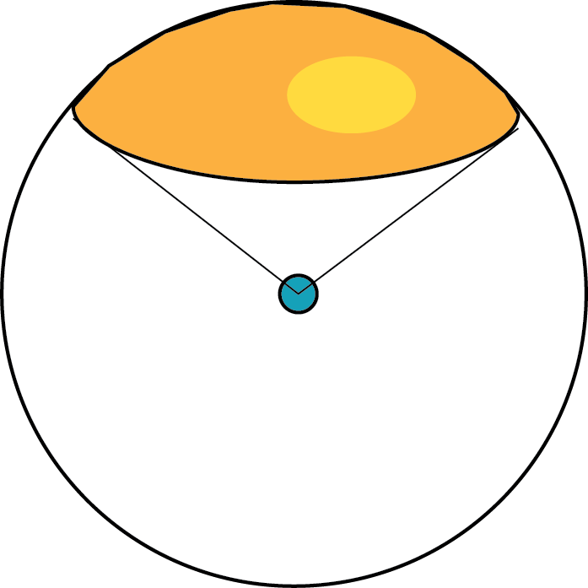



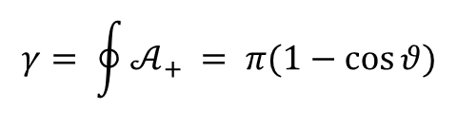
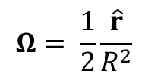
Berry phase, Berry flux and solid angle
Area of cap
$$S\left(θ\right)=2πR^{2}(1−\cos{θ)}$$
$$Ω= \frac{1}{2}\frac{\hat{r}}{R^{2}}$$
Berry flux
$$Φ_{B}=ΩS= π(1−\cos{θ)}$$
g = 1/2
$$𝒜_{+}=\frac{1}{2}(1−\cos{θ) dφ}$$
$$γ= \oint{𝒜_{+} = π(1−\cos{θ)}}$$
Hence Berry phase equals the Berry flux piercing cap

Slide 14
Berry curvature from real-space spin textures

Slide 15
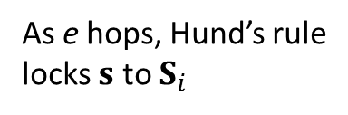
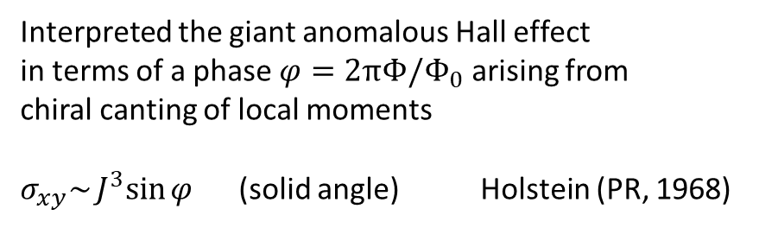
Phys. Rev. B 57 (1998)
electron
Interpreted the giant anomalous Hall effect
in terms of a phase $φ=2πΦ/Φ_{0}$ arising from
chiral canting of local moments
$σ_{xy}\sim J^{3}sin{φ}$ (solid angle) Holstein (PR, 1968)
Mn moment
As e hops, Hund’s rule
locks $s$ to $S_{i}$

Slide 16
Science 2001
Within each tetrahedron, Mo and Nd moments
are canted.
Leads to spin textures (cones).

Slide 17
Berry curvature from spin textures
Produces large AHE.

Slide 18
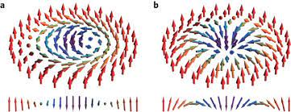
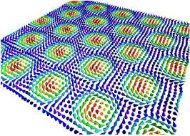
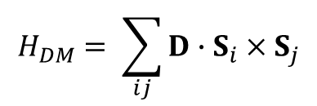
PRL 2009
MnSi, FeGe are metals in B20 symmetry class
Large Dzyaloshinsky-Moriya exchange term
$$H_{DM}= \sum_{ij}{D∙S_{i}×S_{j}}$$
Favors spiral spin textures
Exhibit skyrmions (radial twist of spins)
Carriers scattered from skyrmion spin texture
acquire large Berry phase.

Slide 19
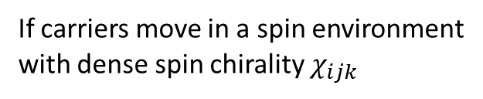

Emergence in MnSi of giant AHE in a narrow interval 0.1—0.4 Tesla under pressure
If carriers move in a spin environment
with dense spin chirality $χ_{ijk}$
$$χ_{ijk}=S_{i}∙S_{j}×S_{k}$$
they acquire a giant AHE from
Berry curvature.
In MnSi, Lee et al. estimate the
equivalent field is 100 Tesla!
AHE vanishes if H aligns all moments.
Giant Hall conductivity from spin texturre

Slide 20
Planar anomalous Hall effect

Slide 21
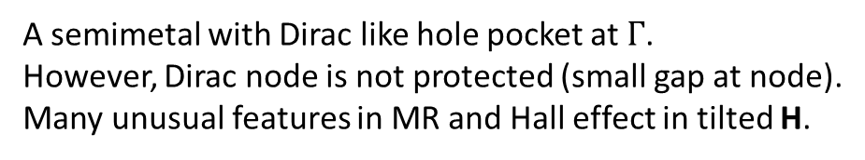
Tian Liang et al., Nat. Phys. 2018
A semimetal with Dirac like hole pocket at $Γ$.
However, Dirac node is not protected (small gap at node).
Many unusual features in MR and Hall effect in tilted H.

Slide 22

Ω
H
$$φ$$
Planar Hall geom.
Large AHE signal even when H lies in plane of applied current (planar Hall effect).
Planar field H produces a Berry curvature Ω that is normal to plane.
First known example of (true) planar Hall effect.

Slide 23
Quantized Anomalous Hall Effect

Slide 24

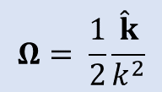
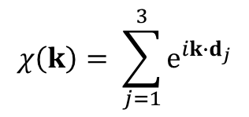








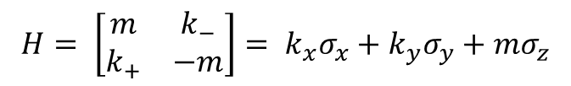
Band structure of graphene
Basis is Wannier 2-spinor $\left(\begin{matrix}w_{a} \\ w_{b}\end{matrix}\right)$
$$H=−t\sum_{k}{χ\left(k\right)|\left.k,a\right\rangle }\left\langle k,b|\right.$$
$$χ\left(k\right)= \sum_{j=1}^{3}{e^{ik∙d_{j}}}$$
E(k)
In one valley K
0
$$H= \left[\begin{matrix}m & k_{−} \\ k_{+} & −m\end{matrix}\right]= k_{x}σ_{x}+k_{y}σ_{y}+mσ_{z}$$
$$σ_{x}=\left(\begin{matrix}0 & 1 \\ 1 & 0\end{matrix}\right)$$
k_{x}
$$H= d(k)∙σ$$
$$d\left(k\right)=\left(k_{x}, k_{y}, m\right)$$
$$σ_{y}=\left(\begin{matrix}0 & −i \\ i & 0\end{matrix}\right)$$
k_{y}
Mimics a spin ½ in a magnetic field $d(k)$
$$σ_{z}=\left(\begin{matrix}1 & 0 \\ 0 & −1\end{matrix}\right)$$
By analogy with the precessing spin ½ problem,
Pauli matrices
$$Ω= \frac{1}{2}\frac{\hat{k}}{k^{2}}$$
$$Ω(k)$$
At Dirac node, we have a monopole Berry curvature.

Slide 25
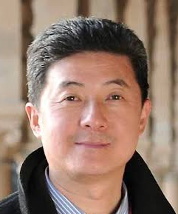
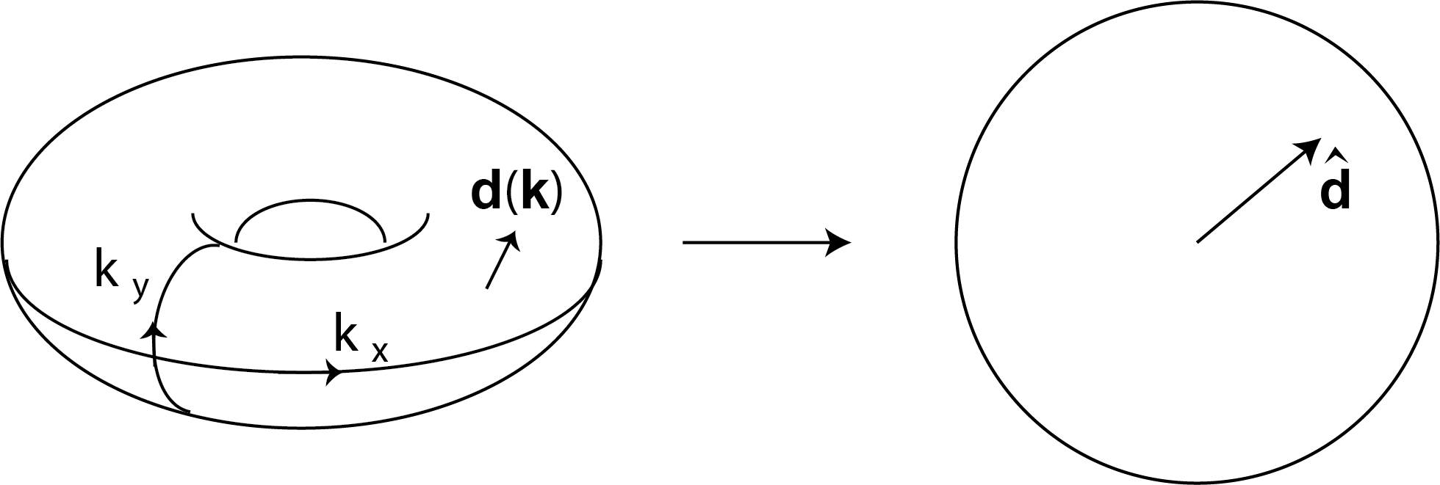

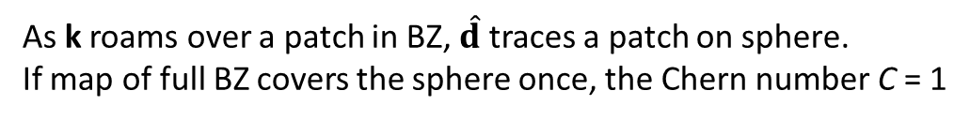


Map of 2D Brillouin Zone to unit sphere
Qi, Wu, Zhang, PRB (2006, 2008)
Qi, Hughes, Zhang, PRB (2008)
$$H= d(k)∙σ$$
$$d\left(k\right)=\left(k_{x}, k_{y}, m\right)$$
Shoucheng Zhang
At each k, the “field” $d(k)$maps to a direction $\hat{d}$on unit sphere $S^{2}$
$$Φ$$
As k roams over a patch in BZ, $\hat{d}$ traces a patch on sphere.
If map of full BZ covers the sphere once, the Chern number C = 1

Slide 26

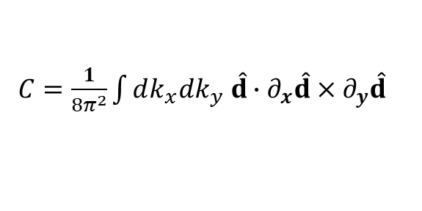


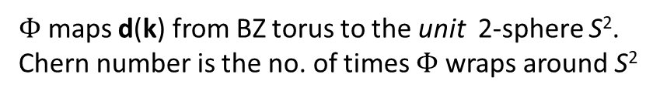
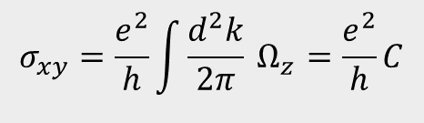

Chern number C and σ_{xy}
2-band Hamiltonian given by
Qi, Wu, Zhang PRB (06, 08)
$$H=d(k)∙σ$$
k_{y}
d
$$Φ$$
$C=\frac{1}{8π^{2}}\int{dk_{x}dk_{y} \hat{d}}∙∂_{x}\hat{d}×∂_{y}\hat{d}$
k_{x}
$$\hat{d}$$
2D Brillouin zone (torus)
sphere $S^{2}$
$Φ$ maps d(k) from BZ torus to the unit 2-sphere S².
Chern number is the no. of times $Φ$ wraps around S²
The 2D Hall conductivity of Chern insulator is the Chern number $C$.
$$σ_{xy}=\frac{e^{2}}{h}\int{\frac{d^{2}k}{2π}}{ Ω}_{z} =\frac{e^{2}}{h}C$$
Thouless et al (TKNN), 1982

Slide 27

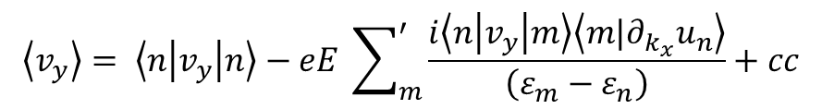

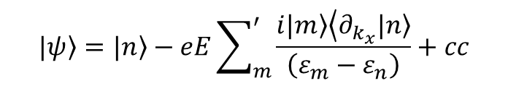

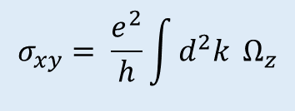
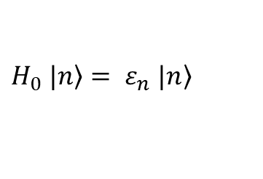






The TKNN conductivity (PRL, 1982)
$$σ_{xy}= \frac{e^{2}}{h}\int{d^{2}k} Ω_{z}$$
Kohmoto 1985
Berry curvature $Ω$
$$H= H_{0}+H_{1}$$
David Thouless
$H_{0} \left.|n\right\rangle = ε_{n}$ $\left.|n\right\rangle$
$$H_{1}=−eE∙R$$
$$R=i ∂/∂_{k}$$
Wannier coord in Bloch rep
$$E∥\hat{x}$$
$$|\left.ψ\right\rangle =\left.|n\right\rangle −eE\sum_{m}^{′}{\frac{\left.i|m\right\rangle \left\langle ∂_{k_{x}}|\left.n\right\rangle \right.}{\left(ε_{m}−ε_{n}\right)}}+cc$$
Perturbed wave func. to first order in H₁
$$\left\langle v_{y}\right\rangle = \left\langle n | v_{y} | n\right\rangle −eE \sum_{m}^{′}{\frac{i\left\langle n | v_{y} | m\right\rangle \left\langle m|\left.∂_{k_{x}}u_{n}\right\rangle \right.}{\left(ε_{m}−ε_{n}\right)}}+cc$$
Velocity along y axis
To eliminate v_{y} matrix inside sum, use
$$v=i\left[H_{0}, R\right]$$
$$\left\langle n | v_{y} | m\right\rangle =\left(ε_{m}−ε_{n}\right)\left\langle n|\left.∂_{k_{y}}u_{m}\right\rangle \right.$$
Velocity in linear response
$$\left\langle v_{y}\right\rangle =ieE \left[\left\langle ∂_{k_{y}}u_{n} | ∂_{k_{x}}u_{n}\right\rangle −\left\langle ∂_{k_{x}}u_{n} | ∂_{k_{y}}u_{n}\right\rangle \right]$$

Slide 28
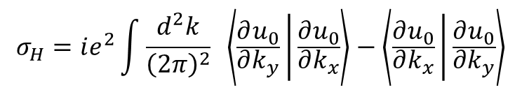


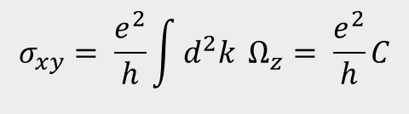
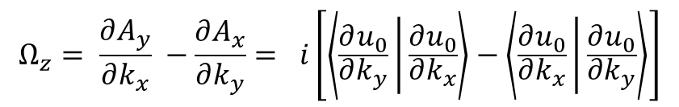

$$\left\langle v_{y}\right\rangle =ieE \left[\left\langle ∂_{k_{y}}u_{n} | ∂_{k_{x}}u_{n}\right\rangle −\left\langle ∂_{k_{x}}u_{n} | ∂_{k_{y}}u_{n}\right\rangle \right]$$
Sum over all k
states to get
$$σ_{H}=ie^{2}\int{\frac{d^{2}k}{{\left(2π\right)}^{2}} \left\langle \frac{∂u_{0}}{∂k_{y}} | \frac{∂u_{0}}{∂k_{x}}\right\rangle −\left\langle \frac{∂u_{0}}{∂k_{x}} | \frac{∂u_{0}}{∂k_{y}}\right\rangle }$$
Define
$$A=i\left\langle u_{k}^{0} | ∇_{k}u_{k}^{0}\right\rangle$$
Berry vector potential (connection)
$$Ω_{z}= \frac{∂A_{y}}{∂k_{x}} −\frac{∂A_{x}}{∂k_{y}}= i\left[\left\langle \frac{∂u_{0}}{∂k_{y}} | \frac{∂u_{0}}{∂k_{x}}\right\rangle −\left\langle \frac{∂u_{0}}{∂k_{x}} | \frac{∂u_{0}}{∂k_{y}}\right\rangle \right]$$
Its curl is $Ω$
$$σ_{xy}= \frac{e^{2}}{h}\int{d^{2}k} Ω_{z}= \frac{e^{2}}{h}C$$

Slide 29

Topological Insulators (TI), Bi₂Se₃, Bi₂Te₃
Fu, Kane, PRB 2007
TRIM
Qi, Hughes, Zhang, PRB 2008
k_{y}
Charlie Kane
States are insulating in the bulk.
Surface states have band-inversion with Dirac states at crossings.
Nodes are protected at TRIM (time-reversal invariant momenta)
by time-reversal invariance.
k_{x}
Surface BZ of TI
If TRI is broken in a magnetic field H or by ferromagnetism,
all Dirac nodes are gapped, leaving metallic chiral edge states.
Edge states will exhibit AHE in zero H.

Slide 30

Qikun Xue et al., Science 2013
Qikun Xue

Slide 33
References
Anomalous Hall effect, Nagaosa et al., RMP 2009
Berry phase effects on electronic properties, Xiao, Chang Niu, RMP 2010
General theorem relating the bulk topological number to edge states in two-dimensional
Insulators, Qi, Wu and Zhang, PRB 74, 045125 (2006)
Quantized Hall Conductance in a Two-Dimensional Periodic Potential,
Thouless, Kohmoto, Nightingale and den Nijs, PRL 49, 405 (1982).
Topological Insulators and Topological Superconductors, Bernevig and Hughes
Princeton Press 2013
Geometry, Topology and Physics, M. Nakahara (Taylor Francis)
Elementary Differential Geometry, Barrett O’Neill

